Slide 1

A Synopsis on enhanced Chat bot with AUDIO Facility
In the field of
Computer Science and Engineering
KIET GROUP OF INSTITUTIONS
Submitted By: Ashwin Saxena
University 1802912018
III Semester / Computer Science (CO) - A

Slide 2
OUTLINE
>> Introduction
> Objective
> Summarization of previous research
>> Acknowledgement
>> Software’s used
>Libraries Used
>Platform
>> Motivation
>> Concepts
>> Processing
>> Program Screenshots
>> Future Scope
>> References

Slide 3
Introduction
All the customers want to get the solution to their problems as soon as possible.
So to solve customers problems more efficiently , Joseph Weizenbaum invented first Chat bot named ELIZA in 1966.
As the new technologies came into existence , chat bots are modified by time.
Now almost every company either service based or product based , every company is integrating chat bot in its website, Android application or iOS or any other form of way that is served to the customer.
But even some people can’t gets satisfied by using chat bot because it feels like using a dummy ,
If we want to it interactive than chat bot should behave like a real service man.
Objective
Objective of this project is to make the conversation interactive and serve the customer well to solve their problems regarding the supply.
It is really helpful to for elders , who find it tough to read so they could listen well and understand what system wants to tell.

Slide 4
Software’s used
Language : Python 2.7
Development Platform :Anaconda Navigator , Jupyter Notebook
Libraries Used :
>random
>io
>strings
>sklearn
>NLTK
>warnings
API Used :
Windows SAPI5 –> Text-to-speech

Slide 5
MotiVATION
After the completion of my Artificial Intelligence training , my instructor asked me to make a real world project .
My instructor always guided us to solve real world problems instead of being theoretical ,that’s what make me motivated all the time.
I built many projects during the training period but unsure about what to present.
Then I go through many popular AI projects and finally decided to make a different one from all ,
Thus built a AUDIO ENHANCED CHAT BOT.

Slide 6
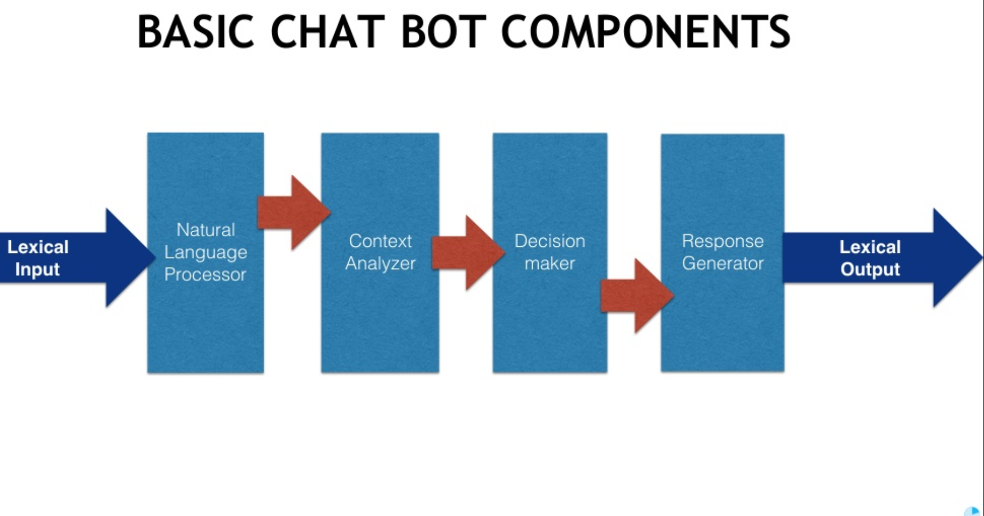

Slide 7
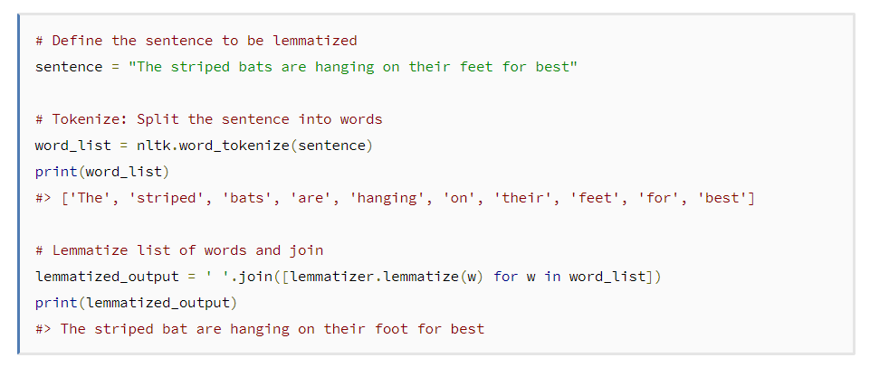
Important concepts
1.) Lemmatization (NLTK)
Lemmatization is the process of converting a word to its base form. Another thing to note about lemmatization
is that it’s often times harder to create a lemmatizer in a new language than it is a stemming algorithm.
Some Lemmatizer-
i.) Wordnet Lemmatizer ii.) Spacy Lemmatizer iii.) TextBlob iv.) CLiPS Pattern

Slide 8
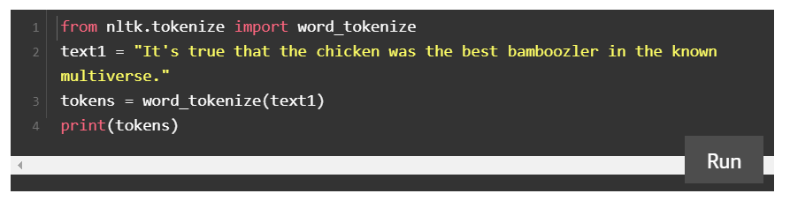
2.) Tokenization
Tokenization is the task of chopping the string into pieces, called tokens, perhaps at the same time throwing away certain characters, such as punctuation.
There are 7 types of tokenization , however this project had used only two-
i.)Word Tokenizer
ii.)Sentence Tokenizer
The output of the above code is such that :
['It', "'s", 'true', 'that', 'the', 'chicken', 'was', 'the', 'best', 'bamboozler', 'in', 'the', 'known', 'multiverse', '.']

Slide 9
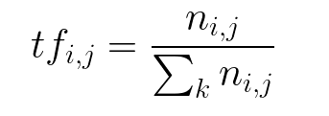
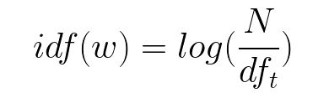
3.)TFIDF Vectorizer (SKLEARN)
It Stands for Term Frequency - Inverse Document Frequency
Term Frequency (TF)
The number of times a word appears in a document divded by the total number of words in the document. Every document has its own term frequency.
Inverse Data Frequency (IDF)
The log of the number of documents divided by the number of documents that contain the word w. Inverse data frequency determines the weight of rare words across all documents in the corpus.

Slide 10
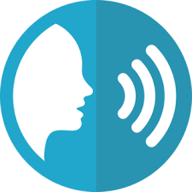

SAPI 5
Microsoft Speech API (SAPI5) is the technology for voice recognition and synthesis provided by Microsoft. Starting with Windows XP, it ships as part of the Windows OS.
Audio
Text

Slide 11
Processing
I have attached a text file that will be containing the replies or data about the services. First the data file with be tokenize into sentence tokens and word tokens .
Then all the words will be converted into its global form or simplest form by Lemmatization to calculate the frequency of each word.
But the meaning or objective of the sentence is calculated by TF-IDF .
Now ,
When user inputs the welcome words like hi , hello ….. Then the output will be the greeting output that is the random choice from the pre defined list.
This is done by random library.
Every output is spoken by the system with the help of SAPI5 API which converts the text into voice and vice-versa.
Every input except greetings , is tokenize and then each token is searched in the data file , and the relevant sentence is represented.
The word are taken as vectors during Term Frequency – inverse document frequency.
All the outputs or Machine Responses are included in NLG .
Outputs depends on Factors like Lemmatization ,TF-IDF.
NLP

Slide 12
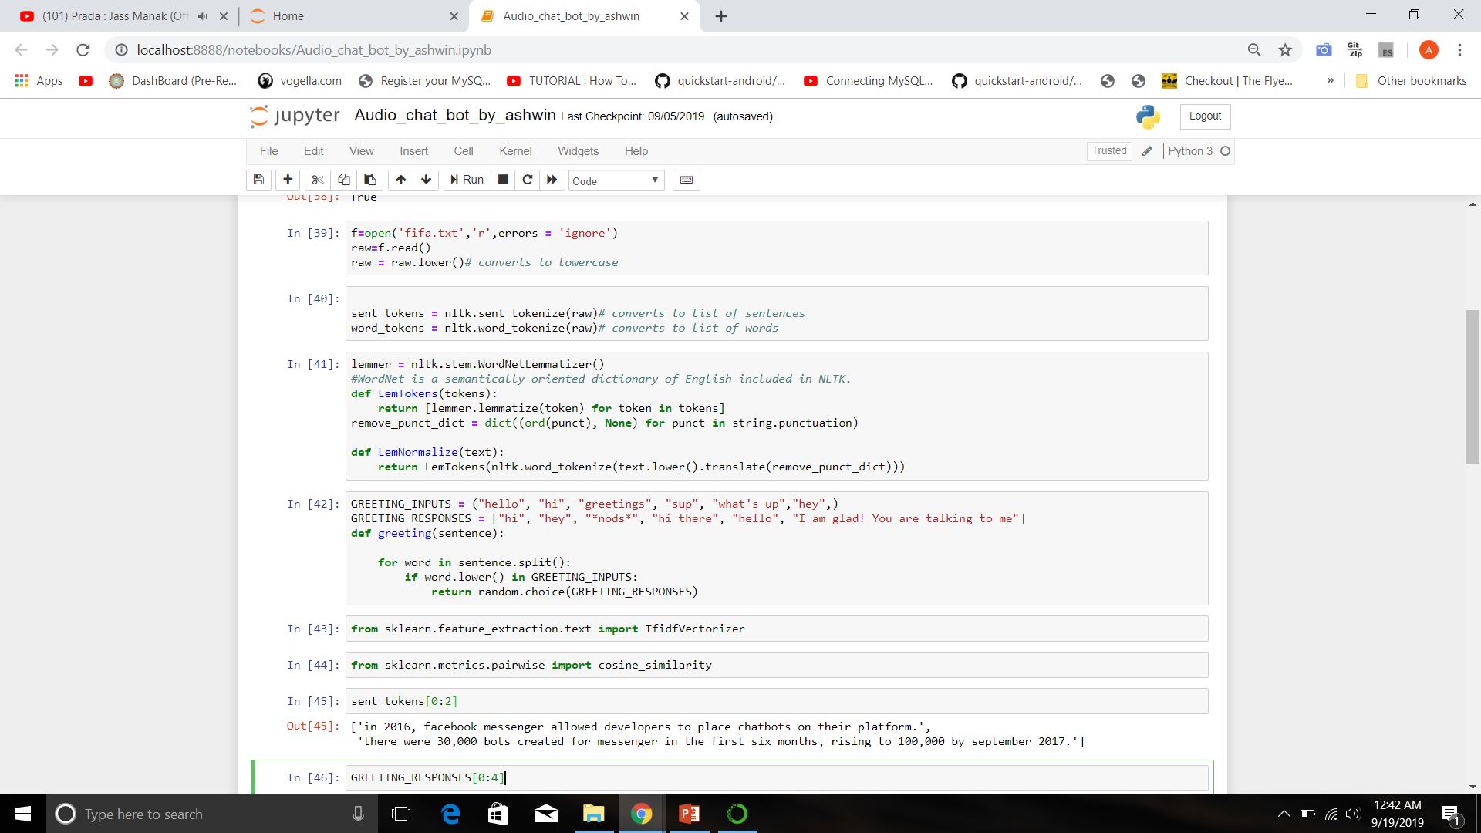
Screenshots

Slide 13
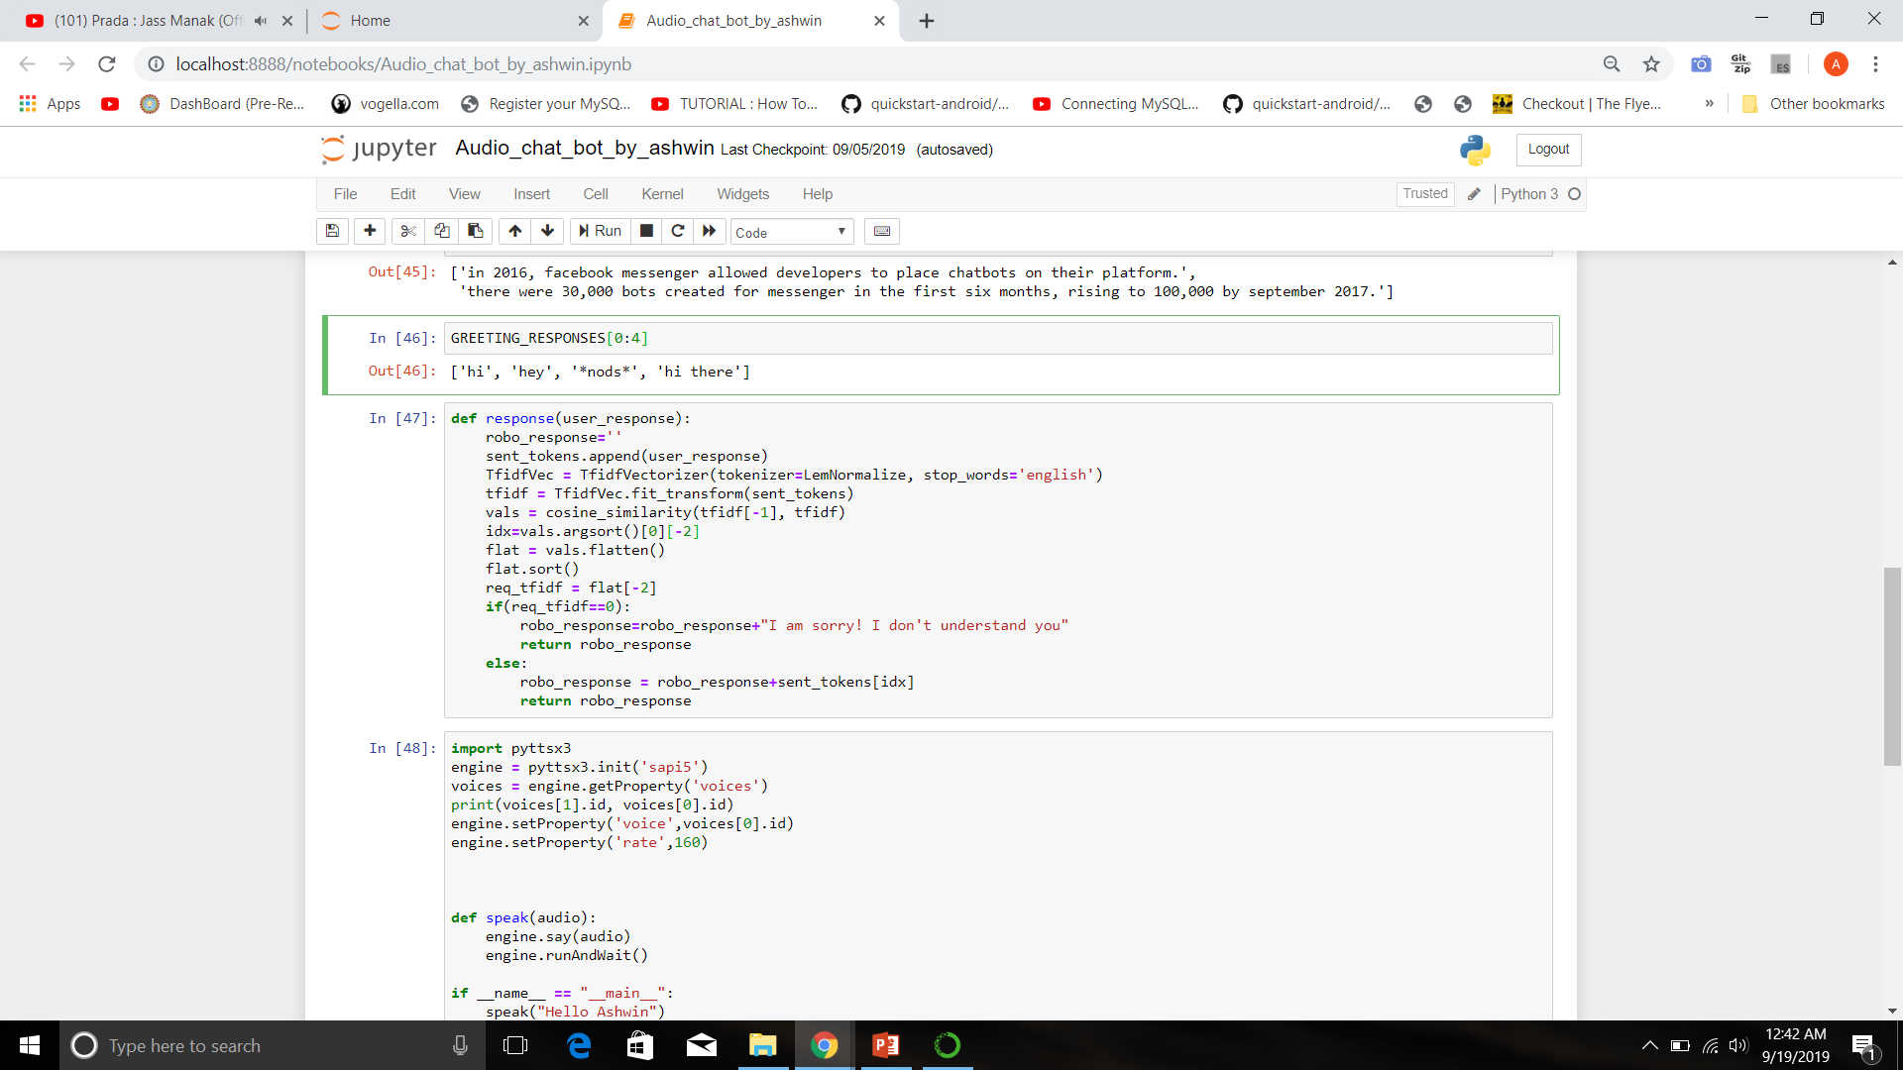

Slide 14
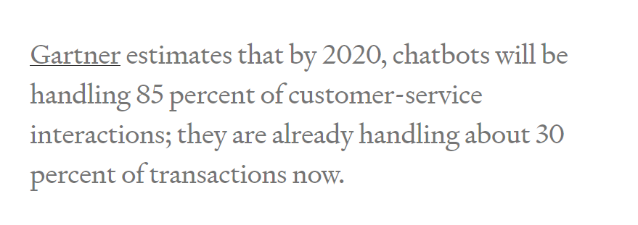
Future scope
Every person wants to get the solution to his/her problem asap , and whenever it comes to solve issues quickly we always use machines.
Here Chat Bot act as a Machine .
Now all the companies are integrating chat bots on their sites or apps . But till now no company had integrated chat bot with a facility to talk .
It is my try to make the services easily accessible to elders or people who find it difficult to read on screen.
One more thing that can be added is that the input format can also be changed to –
>> Speaking the queries as an input.
So why shouldn’t we customize the left portion of this 85% share ;)

Slide 15
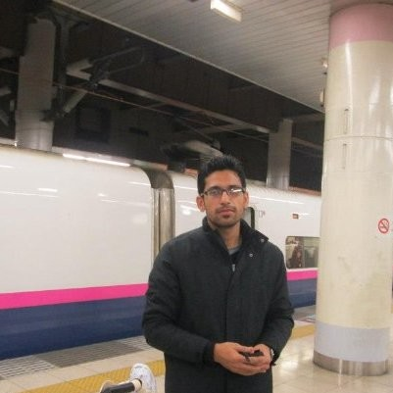
References
Project Supervisor
www.geeksforgeeks.com
www.medium.com
www.towardsdatascience.com
www.analyticsvidhya.com
www.youtube.com
Pulkit Mehndiratta
> Assistant Professor at JIIT Noida
> M.Tech IIITD
> Attended Artificial Intelligence Conference
In US 2 Times

Slide 16
Thank you
Prepared By – Ashwin Saxena
Computer Science (CO)
Roll No : 1802912018
LinkedIn : https://www.linkedin.com/in/ashwin-saxena-494965166/
Github : https://github.com/Ashwin-Saxena

